Slide 1
Generating Missing Data
Learning Objectives:
Propagate values from the previous record using Peek()
Generate records to fill gaps with IterNo() in a WHILE loop
Accumulate transactions to create a balance field
Split a delimited list of values into multiple records using SubField()
Use table join to generate Cartesian product
Monte Carlo simulations: Two thrown dice and initial poker hand
Explain functions used in Qlik’s Sample Data Script
Replace nulls using IsNull() and NullAsValue

Slide 2
Table Generation
RESIDENT
Copy table from memory
Transform as needed
Provide new table name
Drop original table, or keep, if desired
AUTOGENERATE
Build from scratch
Unlimited # rows
Create values as desired

Slide 3

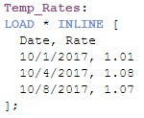
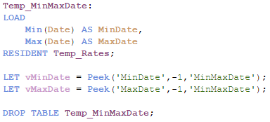

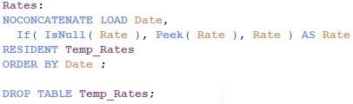
Record Generation
Keywords:
Scenario:
Date
Rate
AUTOGENERATE
Data contains currency conversion rates and change dates
Need to expand list to include all dates with corresponding rates
10/1/2017
1.01
10/2/2017
10/4/2017
1.01
JOIN
1.08
?
10/3/2017
10/5/2017
1.01
1.07
Functions:
Min()
Max()
Peek()
RowNo()
If()
IsNull()
Solution:
Load raw data
Capture oldest and newest dates from raw data table
AUTOGENERATE all dates in range and JOIN to raw data table
Sort by date; propagate rates from top down

Slide 4
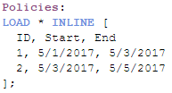

Record Generation
Keywords:
Scenario:
WHILE
Raw data contains insurance policy start and end dates
Need to determine which policies are in effect on any given date
ID
Start
End
1
1
5/1/2017
5/1/2017
5/3/2017
5/3/2017
2
5/3/2017
2
5/3/2017
5/5/2017
5/5/2017
Functions:
IterNo()
Solution:
ID
RefDt
Load raw data
Loop over each input record to create one record per combination of policy and date
1
5/1/2017
1
5/2/2017
1
5/3/2017
2
5/3/2017
2
5/4/2017
2
5/5/2017

Slide 5
Demo

Slide 6
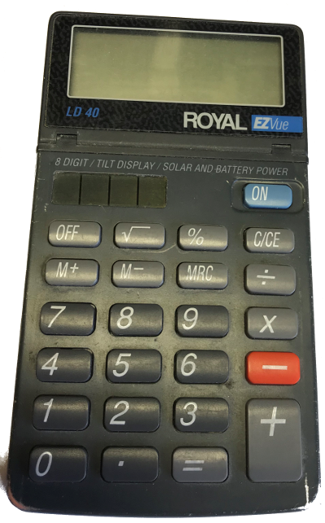
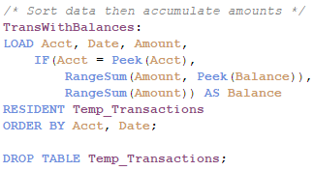
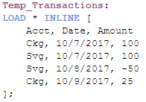
Balance Accumulation
TempTransactions:
Keywords:
Scenario:
Acct
Amount
Acct
Date
ORDER BY
Date
Amount
Raw data contains bank transactions
Need to accumulate transaction amounts to calculate balances
Ckg
10/7/2017
10/7/2017
100
Ckg
100
Svg
Svg
10/7/2017
100
10/7/2017
100
Svg
Svg
10/8/2017
10/8/2017
-50
-50
Ckg
10/9/2017
25
Functions:
Ckg
10/9/2017
25
Peek()
RangeSum()
TransWithBalances:
Solution:
Acct
Date
Amount
Balance
Ckg
10/7/2017
100
100
Ckg
10/9/2017
25
125
Svg
10/7/2017
100
100
Svg
10/8/2017
-50
50

Slide 7
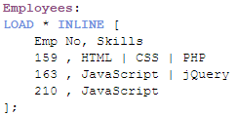

Record Generation - SubField
Employees:
Keywords:
Scenario:
Emp No
Skills
RESIDENT
Raw data contains pipe-delimited list
Need to separate skills into rows
159
HTML | CSS | PHP
163
JavaScript | jQuery
210
JavaScript
Functions:
SubField()
Employees_x_Skills:
Emp No
Skill
Solution:
159
HTML
159
CSS
159
PHP
163
JavaScript
163
jQuery
210
JavaScript

Slide 8
Demo

Slide 9
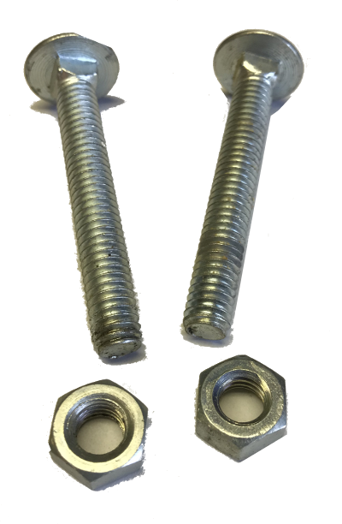
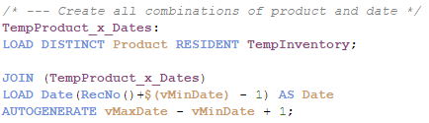
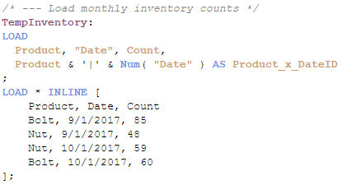
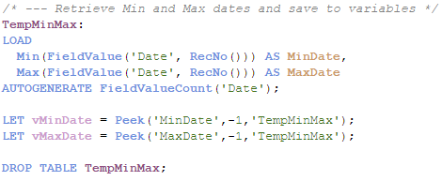
Record Generation – Cartesian Product
Keywords:
Scenario:
TempInventory:
Product
AUTOGENERATE
Raw data contains monthly physical inventory counts
Need to copy inventory counts to all days in between
Product
Date
Count
JOIN
Bolt
Bolt
9/1/2017
85
CONCATENATE
Nut
Nut
9/1/2017
48
NOT EXISTS
Nut
10/1/2017
59
Bolt
10/1/2017
60
Functions:
Peek()
FieldValue()
FieldValueCount()
RecNo()
TempProduct_x_Dates:
(AUTOGENERATE)
Solution:
Product
Date
Date
Bolt
9/1/2017
9/1/2017
2
Nut
…
…
9/2/2017
Bolt
10/1/2017
9/3/2017
31
Nut
9/1/2017
62
…
…
…
10/1/2017
Nut
10/1/2017

Slide 10
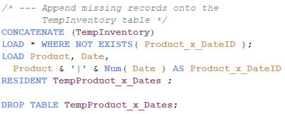
Record Generation – Cartesian Product
Keywords:
TempInventory:
TempInventory:
Product
Date
Product
Count
Date
Product_x_DateID
AUTOGENERATE
Count
JOIN
Bolt
9/1/2017
Bolt
85
9/1/2017
Bolt|42979
85
CONCATENATE
Nut
9/1/2017
Nut
48
9/1/2017
Nut|42979
48
NOT EXISTS
Nut
10/1/2017
Nut
59
10/1/2017
Nut|43009
59
Bolt
10/1/2017
Bolt
60
10/1/2017
Bolt|43009
60
Product & '|' & Num( "Date" ) AS Product_x_DateID
TempProduct_x_Dates:
Solution:
Product
Date
Product_x_DateID
Bolt
9/1/2017
Bolt|42979
…
…
…
Bolt
10/1/2017
Bolt|43009
Nut
9/1/2017
Nut|42979
…
…
…
Nut
10/1/2017
Bolt|43009

Slide 11
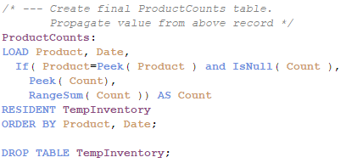
Record Generation – Cartesian Product
Keywords:
TempInventory:
AUTOGENERATE
Product
Date
Count
JOIN
Bolt
9/1/2017
85
CONCATENATE
Nut
Bolt
9/1/2017
9/2/2017
48
85
NOT EXISTS
Nut
Bolt
10/1/2017
9/3/2017
59
85
Bolt
Bolt
10/1/2017
9/4/2017
60
85
Bolt
9/5/2017
85
Bolt
9/6/2017
85
Solution:
Bolt
9/7/2017
85
…
…
…
Bolt
10/1/2017
60
Nut
9/1/2017
48
Nut
9/2/2017
59
…
…
…

Slide 12
Demo

Slide 13

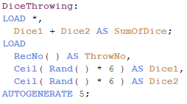
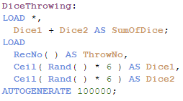
Simulation – Dice
Keywords:
DiceThrowing:
AUTOGENERATE
Throw#
Dice1
Dice2
SumOfDice
1
5
4
9
0.46282547153533
2
1
6
7
2.77695282921198
3
Functions:
3
6
6
12
Rand()
Ceil()
RecNo()
Ceil( Rand( ) * 6 )
4
6
5
11
5
5
3
8
…
Solution:

Slide 14

Simulation – Cards
Solution Outline
Create deck
Shuffle and deal
Identify flush
Identify combinations
Evaluate combinations
Create outcomes table
A Royal Flush is a hand with the cards:
10, Jack, Queen, King, and Ace all in the same suit
A Flush is a hand with:
Five cards in any order in the same suit

Slide 15
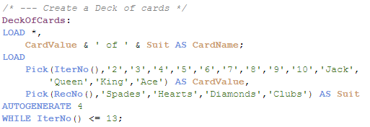
Cards – Create Deck
Keywords:
DeckOfCards:
AUTOGENERATE
IterNo()
RecNo()
CardValue
Suit
1
2
13
1
2
3
WHILE
4
2
Spades
2
Hearts
2
Diamonds
Functions:
Pick()
RecNo()
IterNo()
2
Clubs
3
Spades
Solution:
3
Hearts
3
Diamonds
3
Clubs
…

Slide 16
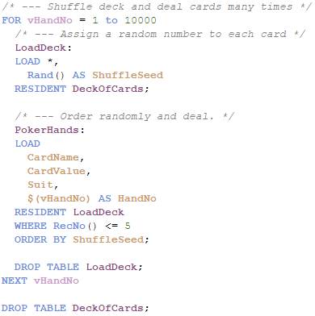
Cards – Shuffle & Deal
Keywords:
FOR NEXT
ORDER BY
RESIDENT
WHERE
PokerHands:
Functions:
CardValue
Suit
HandNo
Rand()
RecNo()
3
Diamonds
1
Solution:
9
Clubs
1
10
Diamonds
1
King
Spades
1
10
Spades
1
4
Diamonds
2
4
Clubs
2
Queen
Diamonds
2
Ace
Hearts
2
6
Spades
2
…

Slide 17
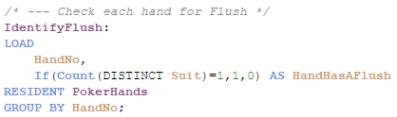
Cards – Identify Flush
Keywords:
Functions:
RESIDENT
GROUP BY
If()
Count()
Solution:

Slide 18
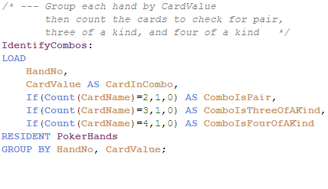
Cards – Identify Combinations
Keywords:
Functions:
RESIDENT
GROUP BY
If()
Count()
Solution:

Slide 19

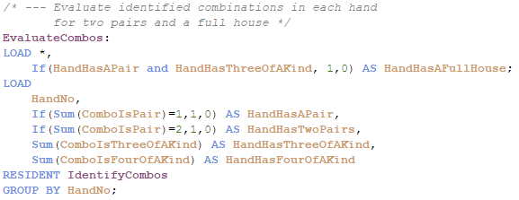
Cards – Evaluate Combinations
Keywords:
Functions:
RESIDENT
GROUP BY
If()
Sum()
Solution:
A Full House is a hand with the combination:
One pair and Three of a kind

Slide 20
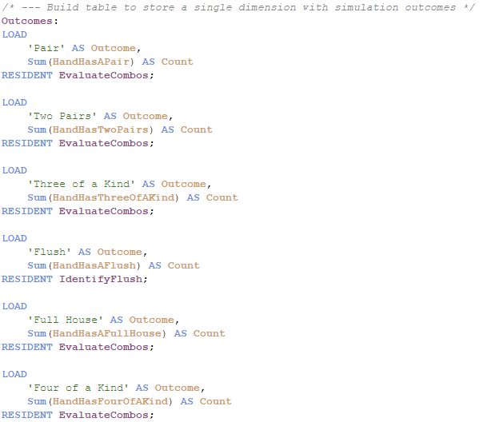
Cards – Create Outcomes Table
Keywords:
Solution:
RESIDENT
Functions:
Sum()

Slide 21
Demo

Slide 22
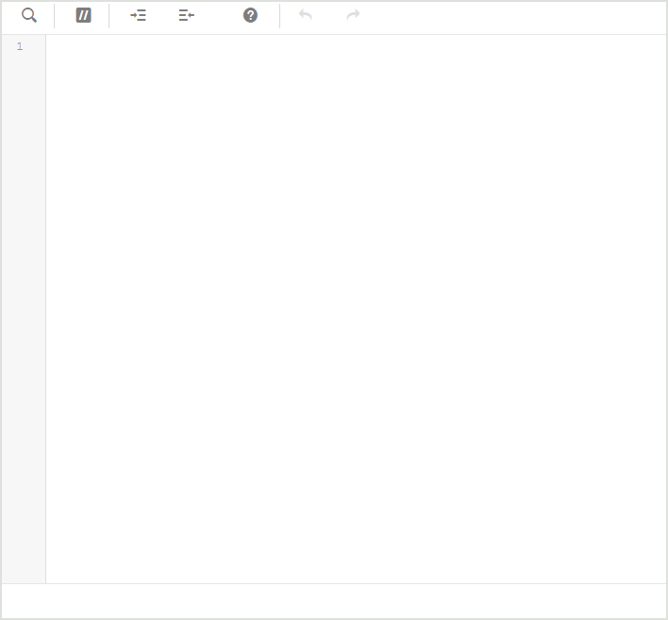
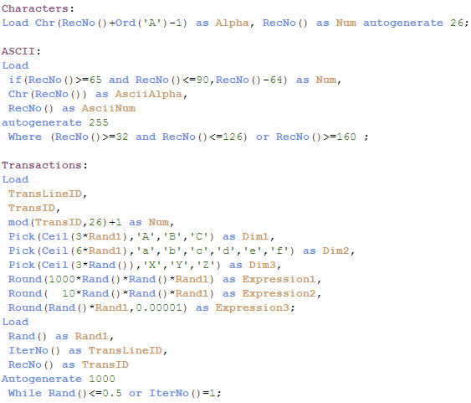
Sample Data
Ctrl + 0 + 0
Ord() converts a character to its Unicode number

Slide 23
Sample Data
ASCII:
AsciiNum
32
1
33
2
…
3
126
4
RowNo() points to current row in internal table
5
RecNo() points to current row in source data
160
6
161
7
…
8
255
…

Slide 24
Sample Data

Slide 25
Demo

Slide 26
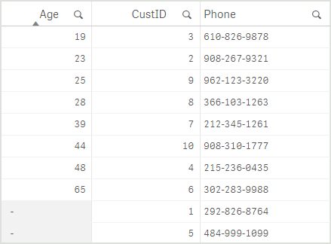
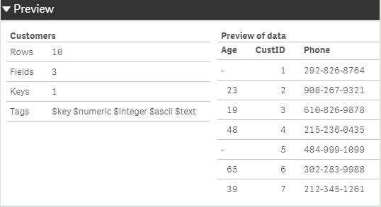
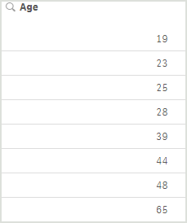

Replacing Nulls
NullAsValue "Age";
SET NullValue = 'NULL';
…
NullAsNull *;
If (IsNull("Age"), 'NULL', "Age") AS "Age";
SET NullDisplay = 'NULL'; converts ODBC data
0
Chr(32)
“”

Slide 27
Demo

Slide 28

Concept Review
Insurance Policy Dates:
Ctrl + 0 + 0
ID | Start | End
1 | 5/1/2017 | 5/3/2017
2 | 5/3/2017 | 5/5/2017
Frankie | Leadership, Adaptability, Conflict Resolution, Communication
Johnny | HTML, CSS, PHP, JavaScript, jQuery, Visual Basic, C++, Java
NullAsValue "Age";
SET NullValue = 'NULL';
…
NullAsNull *;
Keywords:
Functions:
Ceil()
Count()
FieldValue()
FieldValueCount()
If()
IsNull()
IterNo()
Max()
Min()
Peek()
Pick()
Rand()
RangeSum()
RecNo()
RowNo()
SubField()
Sum()
AUTOGENERATE
CONCATENATE
FOR NEXT
GROUP BY
JOIN
NOT EXISTS
ORDER BY
RESIDENT
WHERE
WHILE
Ceil()
Count()
FieldValue()
FieldValueCount()
If()
IsNull()
IterNo()
Max()
Min()
AUTOGENERATE
CONCATENATE
FOR NEXT
GROUP BY
JOIN
NOT EXISTS
ORDER BY
RESIDENT
WHERE
WHILE
Peek()
Pick()
Rand()
RangeSum()
RecNo()
RowNo()
SubField()
Sum()
If (IsNull("Age"), 'NULL', "Age") AS "Age";

